Slide 1
Starting a Tax Return - TaxSlayer Basic Information
Form 13614-C Intake/Interview Form
Pub 4012 Tab N “Using TaxSlayer Pro Online”
NJ 1040 Pages 1 and 2
Notes:
1

Slide 2
TS – General TaxSlayer Hints
Log in to TaxSlayer by following directions provided by your district
Welcome page allows you to start a new return or do a client search for an existing return
Once in a return, you can move from one return to another quickly by clicking on taxpayer name at top left and choose “Your Office.” Brings you to Welcome page
Seven main sections to TaxSlayer (left column):
Basic Information

Slide 3
TS – General TaxSlayer Hints
(cont’d)
Federal Section
Health Insurance
State Section
Summary/Print
e-File
Amended Return
Each section may have sub-sections (top of screen)
Must click on Continue to save entries on a screen (no automatic save)
Can view 1040 by clicking on Summary/Print. Click on any amount in blue in right column to go to source of amount
Notes:
3

Slide 4
TS – General TaxSlayer Hints
(cont’d)
To view any form other than 1040, click on Preview Return and then Print Your Tax Return. Will create a PDF of full return, including NJ forms
Enter a form # or topic in Enter the Form Number box on upper left to find requested data entry section
If screen is inactive for 17 minutes, you will receive warning that session will expire in 3 minutes. Can choose whether to renew or not
If TaxSlayer logs out before you click on Continue, data on that screen will not be saved
Notes:
re
4

Slide 5
TS – General TaxSlayer Hints
(cont’d)
Federal and State refunds are displayed at top of screen
AGI is not displayed
If a required field is incorrect or missing on a screen when you click Continue, TaxSlayer will display a warning in red at top of screen
Click on warning to go to error to correct it
Enter a date without a leading zero
TaxSlayer determines whether to use Form 1040, 1040A, or 1040EZ for a particular client
Notes:
re
5

Slide 6
TS – Start a New Return and Enter Taxpayer/ Spouse Information in Basic Information Section
Once screening and interviewing is done, counselors can start the tax return in TaxSlayer
Click on Start New Tax Return
If need to do a prior year return, choose Tax Year 201x Returns instead. Then click on Create Prior Year
Choose one of available taxpayer profiles
Enter and confirm SS # of first taxpayer. Then click on Start Return
Basic Information Section has 3 sub-sections (top of screen):
Filing Status
Personal Information (Taxpayer and Spouse)
Dependents

Slide 7
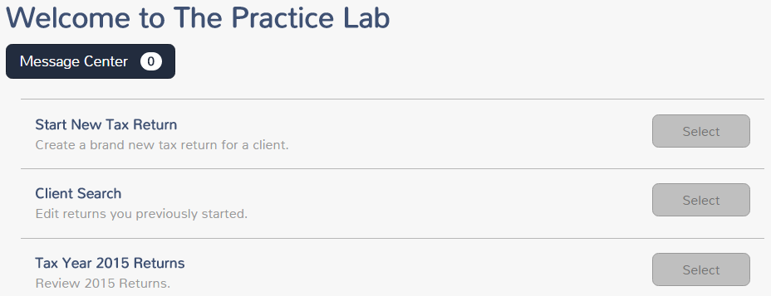
TS – Start a New Return
Start a new tax return

Slide 8
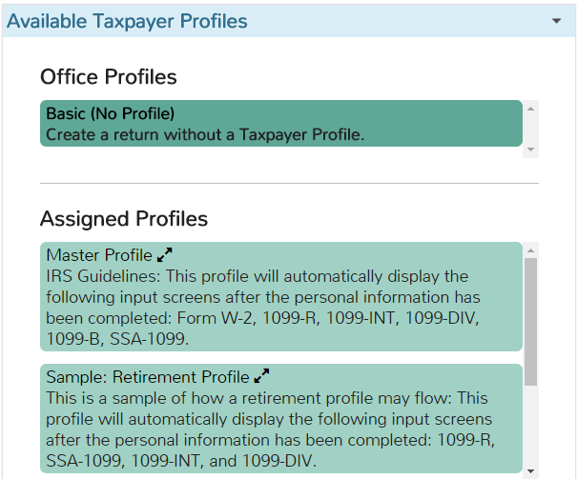
TS – Choose a Taxpayer Profile
Click on desired profile; TS will display most common income & adjustment entry screens to match taxpayer situation

Slide 9
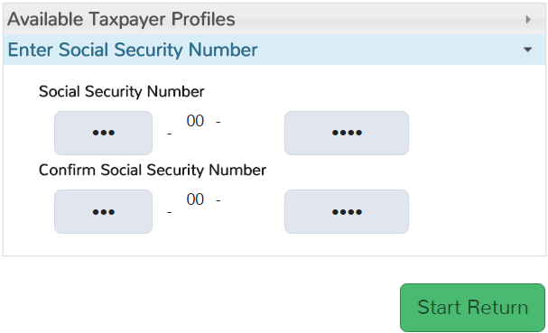
TS – Enter Taxpayer Social Security Number
Enter SS #
Confirm SS #

Slide 10
TS – Methods for Entering Information into TaxSlayer
Possible methods for entering information into TaxSlayer
Taxpayer Profiles created by site administrator
Automatically displays income and adjustment entry pages that most closely reflect information from the taxpayers visiting your site
Quickfile created by counselor for one particular tax return after entering Basic Information
Click on drop-down menu next to taxpayer’s name in upper left of screen
Choose Quick File
Start typing form name or description of screens you will need for this particular return. Select each one to make a list. When list is complete, hit Continue
TaxSlayer will guide you to each screen in order; saves navigation steps
Notes:
10

Slide 11
TS – Methods for Entering Information into TaxSlayer
(cont’d)
Search Box
Enter form # or name in search box above left menu to go to desired input screen
Form 1040
Go to 1040 under Summary/Print section
Click on 1040 line in blue to go to entry screen for that info
Guide Me
TaxSlayer will guide you step-by-step through the return by asking questions
Enter Myself
Navigate yourself to the screens you need for a particular return
Notes:
11

Slide 12
TS – Filing Status
Choose appropriate filing status
Filing Status Wizard is available to help determine proper filing status through guided questions
TaxSlayer will tell you correct status based on your answers, but you must still click on correct filing status line

Slide 13
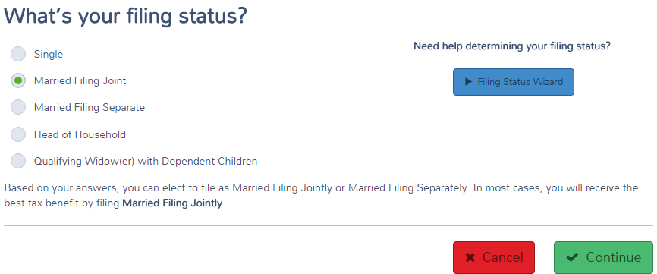
TS – Filing Status Basic Information Section \ Filing Status
Counselor clicks on appropriate
status
From Filing Status Wizard

Slide 14
TS – Personal Information about Taxpayer & Spouse
Enter information about taxpayer and spouse in Federal section \ Personal Information
Name (Spouse’s last name pre-populated based on taxpayer’s; change if necessary)
Social Security # (Taxpayer’s # populated from # used to start return)
Date of birth
Occupation
Address (enter zip code, city/state then populated)
Desire to contribute to Presidential Election Fund
Note Gubernatorial Election Fund desire on the NJ Checklist for later entry in the TaxSlayer State section
Other situation-specific questions

Slide 15
TS – Personal Information about Taxpayer & Spouse Basic Information section \ Personal Information
Name
Date of birth
SS # from start of return
Check boxes that apply
Presidential Election Fund

Slide 16
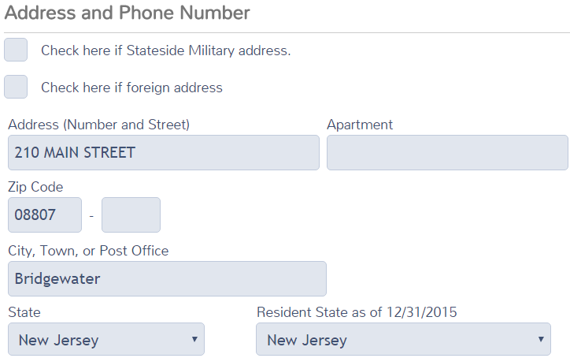
TS – Personal Exemption for Taxpayer & Spouse Basic Information Section \ Personal Information (cont’d)
Address
Enter zip code; TS populates city & state
Resident state as of 12/31;
Determines which state return to file

Slide 17
TS – TS Automatically Starts NJ Return
Based on Resident State as of 12/31 entry, TS automatically starts the appropriate state return
Makes NJ refund monitor available as soon as first income entry is made
To start the NJ return, must answer 4 basic questions:
County/Municipality code
Health insurance for dependents
Gubernatorial Elections Fund
Taxpayer/Spouse PINs (created by counselor)
Notes:
TS starts the state return as soon as Personal Information is entered. This allows you to see the NJ refund monitor as soon as you start entering income
TS entries can almost always be made in any order. However, we recommend that you complete sections in the order of the Main Menu
As you enter data in the Federal section, note any information that may have to be changed on the NJ return due to different tax law. Capture that information on the NJ Checklist so that you don’t forget to enter it when you get to the State section
Also helpful in Quality Review process
Instructions for special fields and adjustments are given in the slides covering both federal and NJ entry for each topic

Slide 18
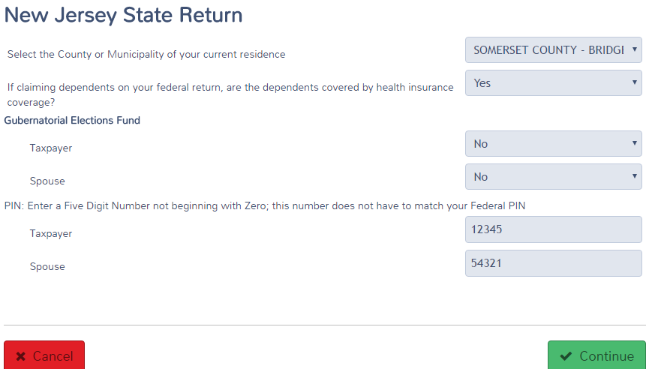
TS – Basic Questions to Start NJ Return
Municipality code
Dependents health insurance
Gubernatorial Election Fund
NJ PIN; does not have to match Federal PIN

Slide 19
TS – Dependent Information
To enter information about a dependent and/or qualifying person:
Name (Last name pre-populated based on taxpayer’s; change if necessary)
Date of Birth
Social Security #
Relationship
Number of months living in home
If dependent was born/adopted/died in tax year, # of months is 12
Can choose reason if dependent did not live in home (lived in Canada or Mexico, divorced/separated, kidnapped, etc.)
Other situation-specific questions

Slide 20
TS – Dependent Information Basic Information \ Dependents\Qualifying Person
Name
Date of birth
SS #
Relationship
# of months in home; 12 if born, adopted or died during year
Check boxes that apply

